Slide 1
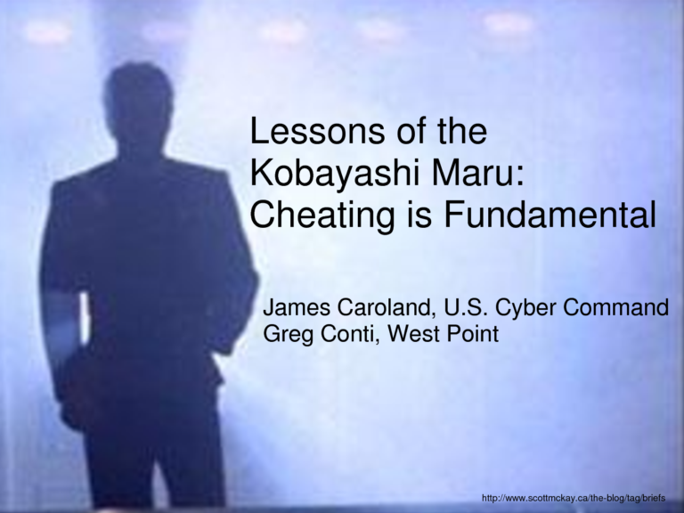
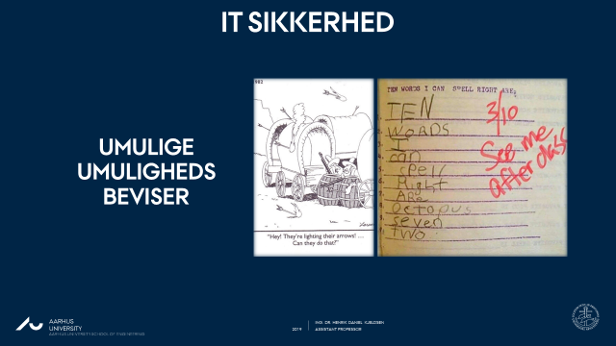
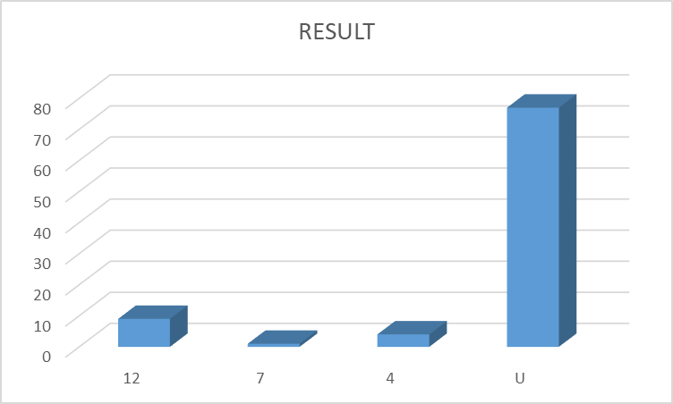
Kobayashi maru RESULTS
https://www.youtube.com/watch?v=v0JHDr1oT0Y

Slide 2
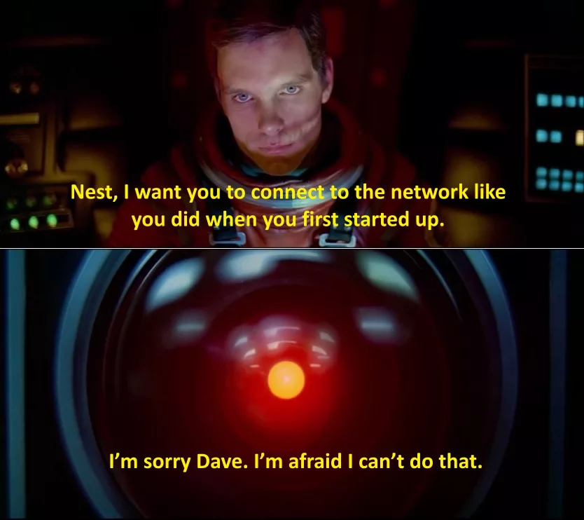
(u)Sikre operativ systemer
IT SIKKERHED

Slide 3
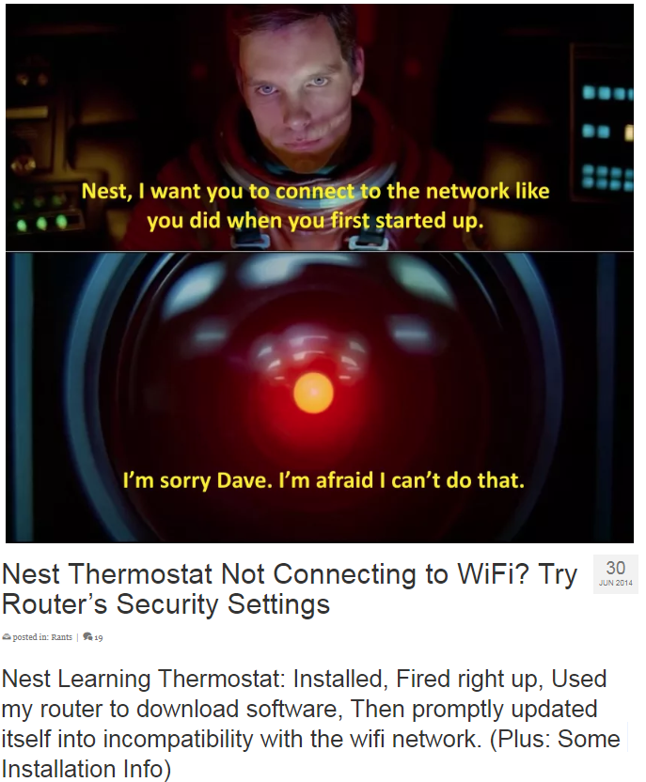
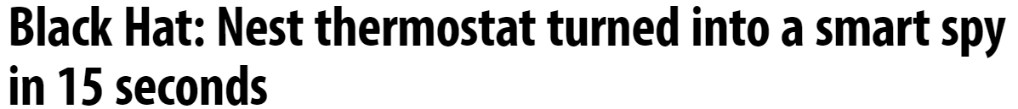
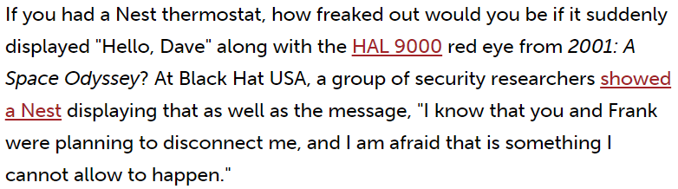
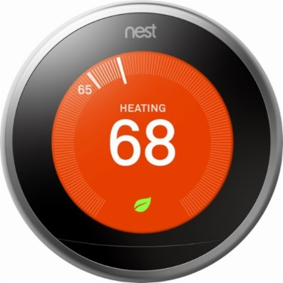
(U)Sikre Operativ systemer

Slide 4
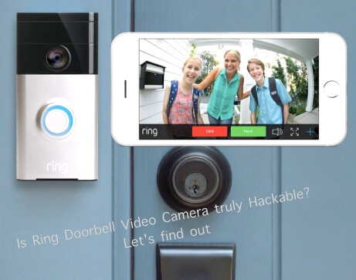
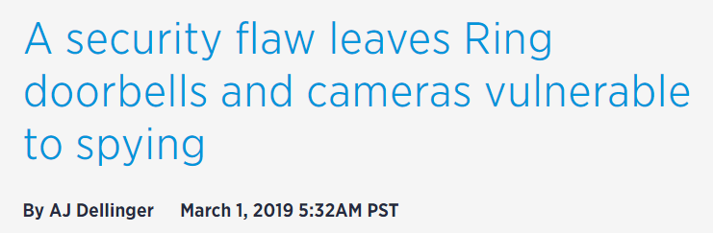
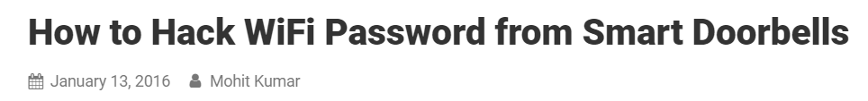
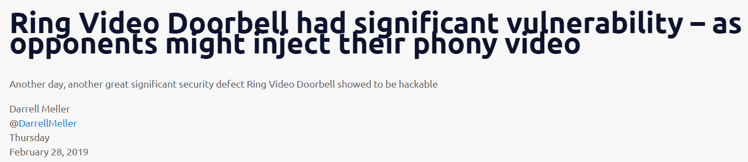
(U)Sikre Operativ systemer

Slide 5
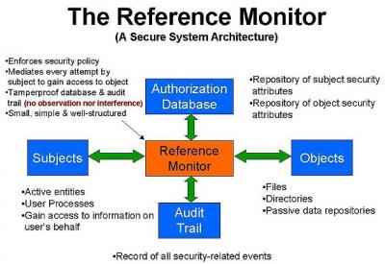
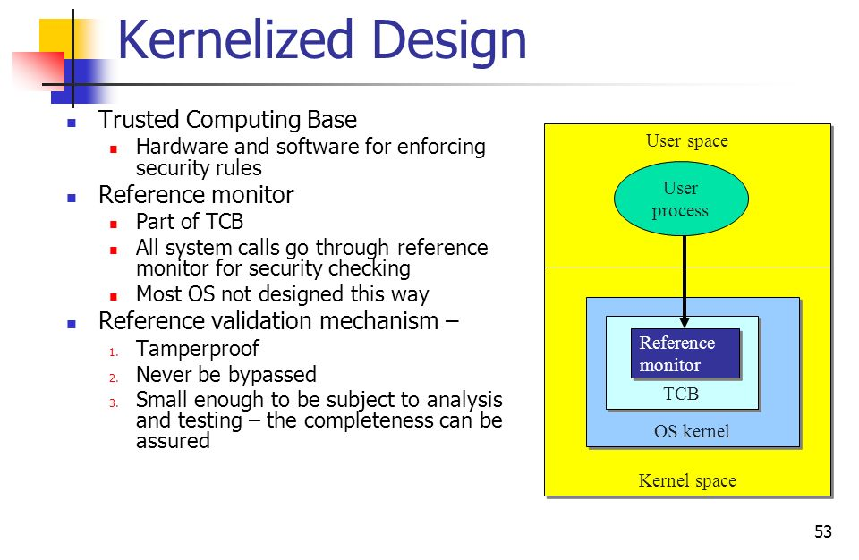
Reference monitor
https://slideplayer.com/slide/9302705/

Slide 6
Reference monitor
For tamperproofing, the problem is that most systems have a trusted computing base that is too large to determine whether tampering is prevented.
In many systems, several user-level processes are trusted with the authority to modify the kernel (e.g., install modules), but many of these processes themselves are vulnerable to tampering.
However, verification is the most difficult of the requirements to satisfy, as designing a general algorithm to prove that an arbitrary program behaves correctly is tantamount to solving the Halting problem.
While current algorithms can prove correctness properties of specific programs, the variety of reference validation code and the complexity of correctness properties preclude verification for all but the smallest, most specialized systems.
https://pdfs.semanticscholar.org/c93c/234c9a7698038caf317a97405c53144bf354.pdf

Slide 7
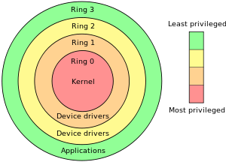
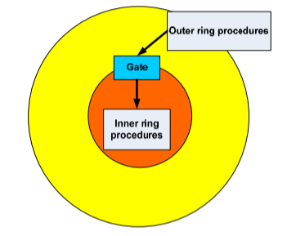
Beskyttelses lag (ringe)
Protection rings
System calls can be roughly grouped into five major categories:
Process Control
load
execute
end, abort
create process (for example, NtCreateProcess in the Windows NT Native API)
terminate process
get/set process attributes
wait for time, wait event, signal event
allocate, free memory
File Management
create file, delete file
open, close
read, write, reposition
get/set file attributes
Device Management
request device, release device
read, write, reposition
get/set device attributes
logically attach or detach devices
Information Maintenance
get/set time or date
get/set system data
get/set process, file, or device attributes
Communication
create, delete communication connection
send, receive messages
transfer status information
attach or detach remote devices

Slide 8
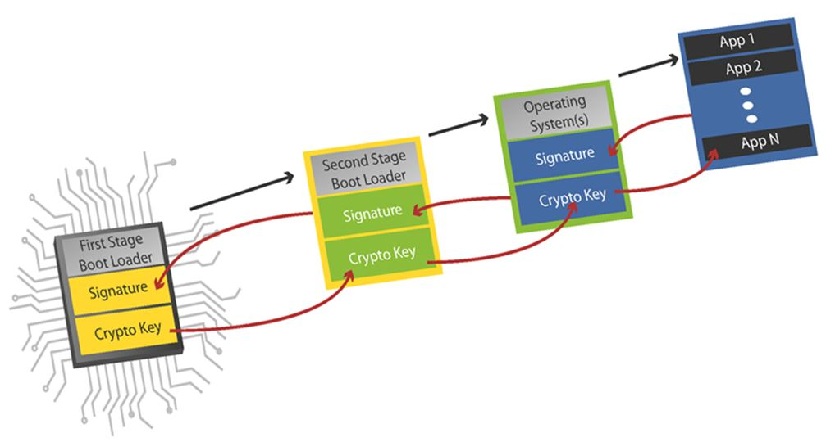
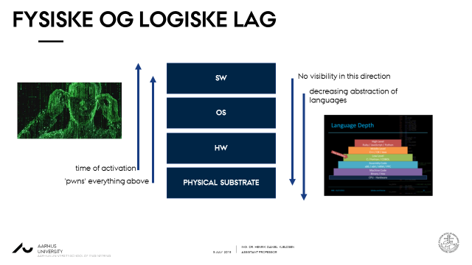
BELOW RING 0
Protection rings
https://blogs.mentor.com/embedded/blog/2016/10/13/enabling-security-across-the-iiot-trust-from-the-bottom-up/

Slide 9
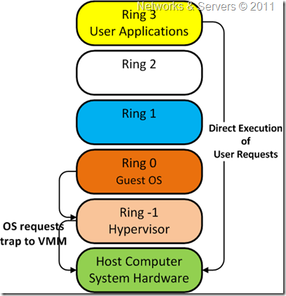
BELOW RING 0
Protection rings

Slide 10
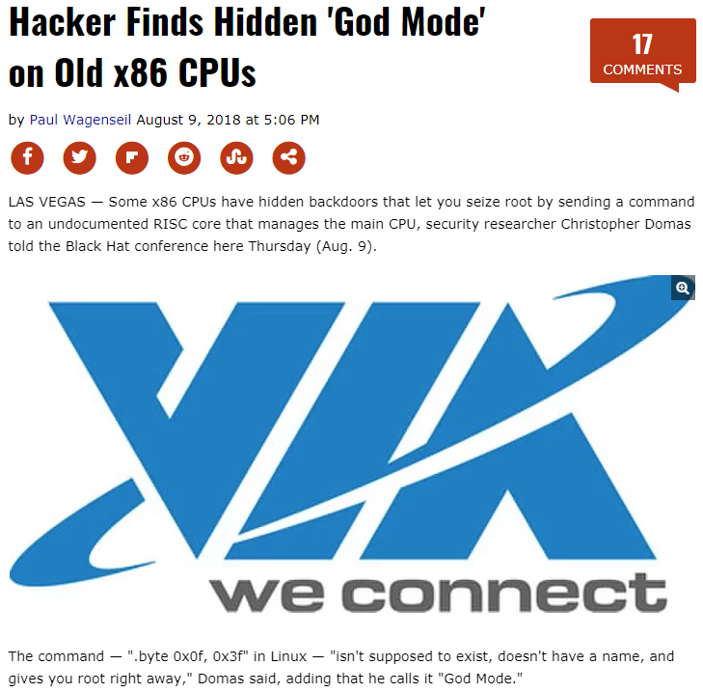
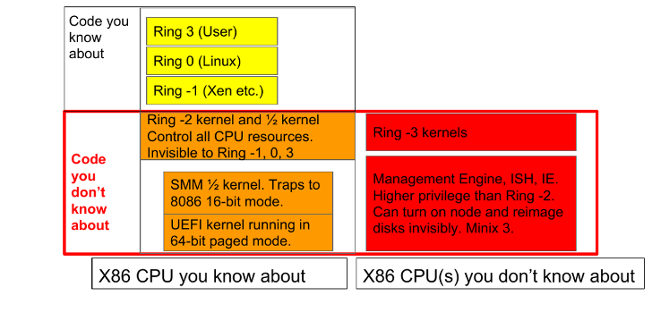
BELOW RING 0

Slide 11
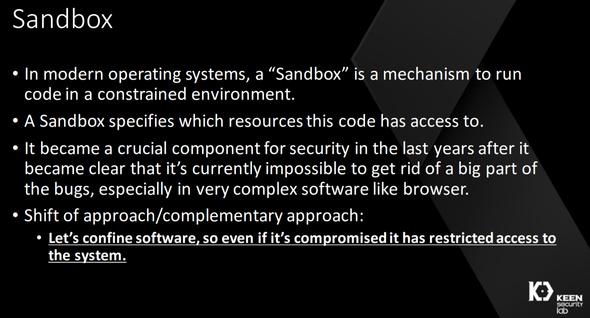
ESCApING THE SANDBOX

Slide 12

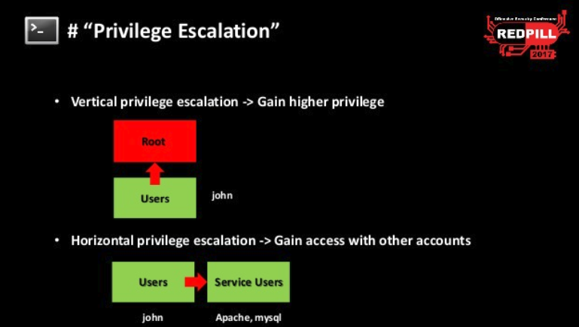
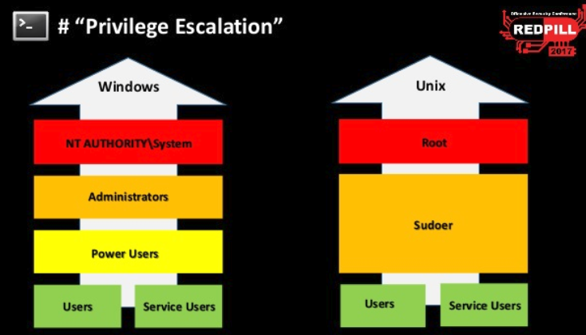
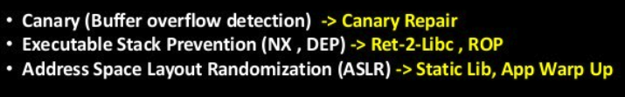
ESCApING THE SANDBOX
Privilege escalation

Slide 13
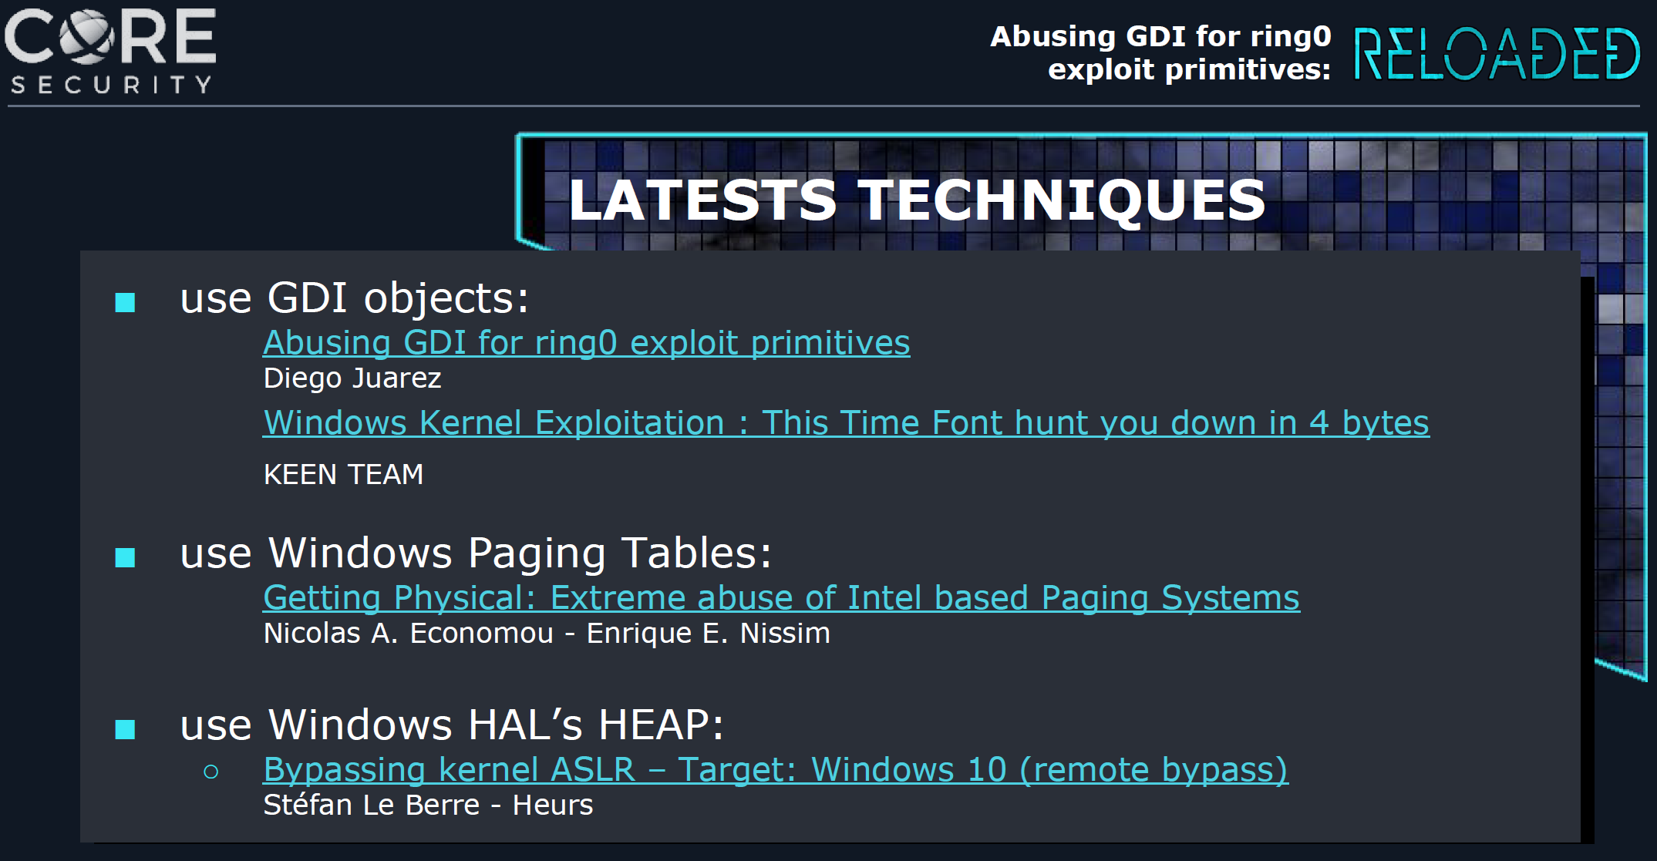
ESCApING THE SANDBOX

Slide 14
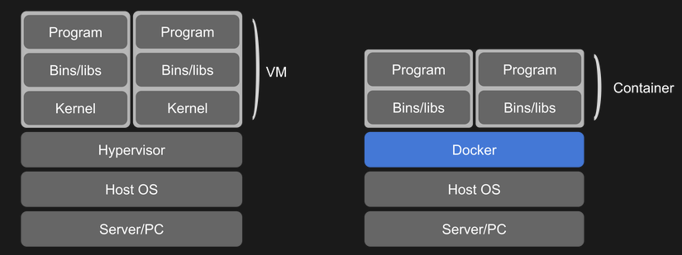

ESCApING THE CONTAINER
Containers share the kernel..
https://hackaday.com/2018/09/05/intro-to-docker-why-and-how-to-use-containers-on-any-system/

Slide 15
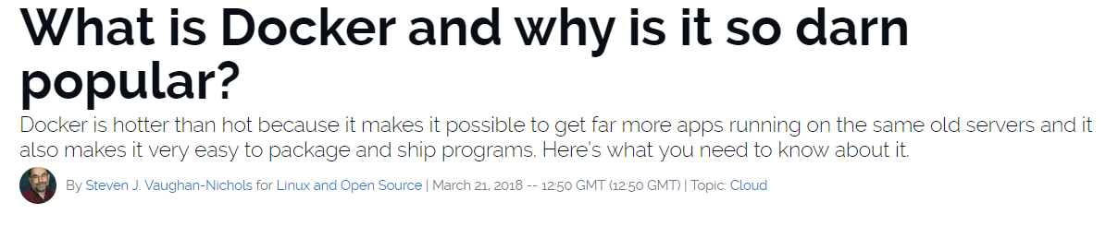
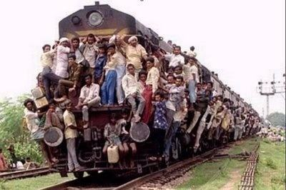
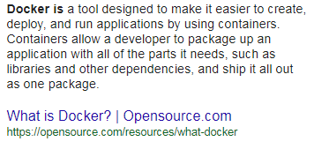
ESCApING THE CONTAINER

Slide 16

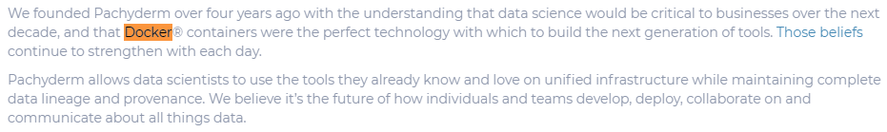
ESCApING THE CONTAINER
“Github for data”
http://www.pachyderm.io/2018/11/15/Series-A.html

Slide 17
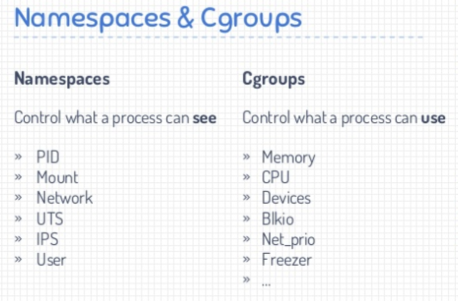
ESCApING THE CONTAINER
https://www.slideshare.net/BorgHan/hacking-docker-the-easy-way

Slide 18
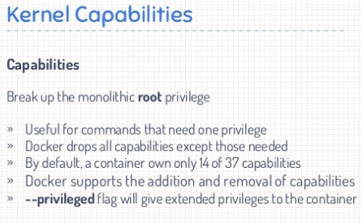
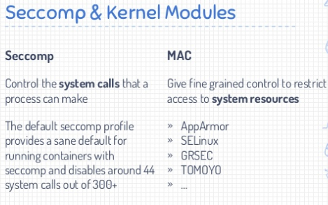
ESCApING THE CONTAINER
https://www.slideshare.net/BorgHan/hacking-docker-the-easy-way

Slide 19
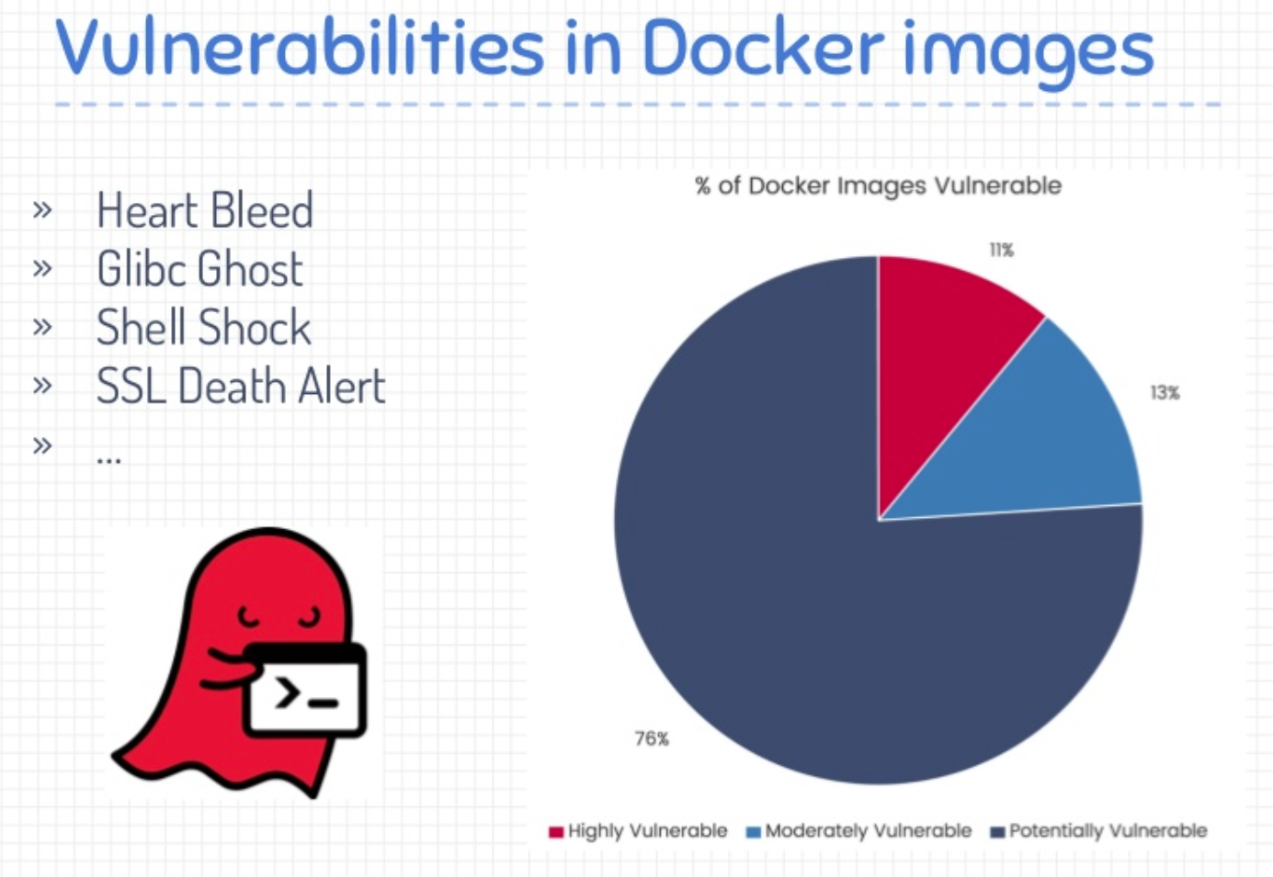
ESCApING THE CONTAINER
https://www.slideshare.net/BorgHan/hacking-docker-the-easy-way

Slide 20
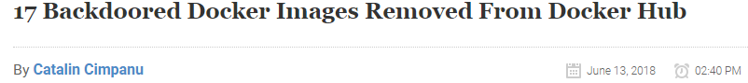
ESCApING THE CONTAINER
https://thenewstack.io/four-security-lessons-live-container-hacking/

Slide 21
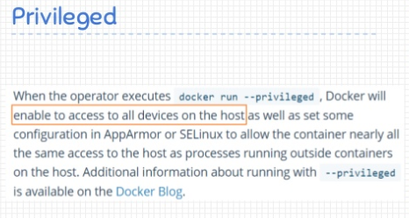
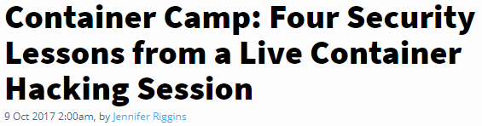
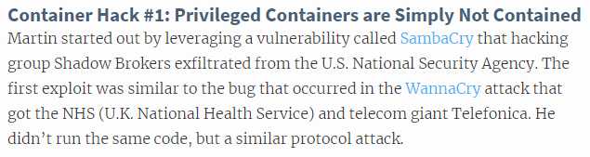
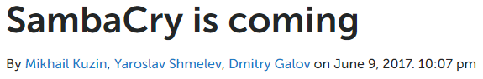
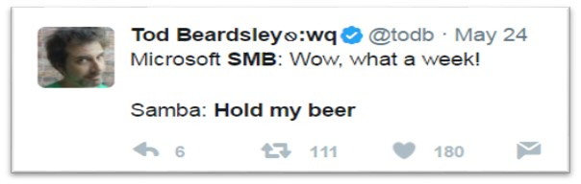
ESCApING THE CONTAINER
https://thenewstack.io/four-security-lessons-live-container-hacking/

Slide 22
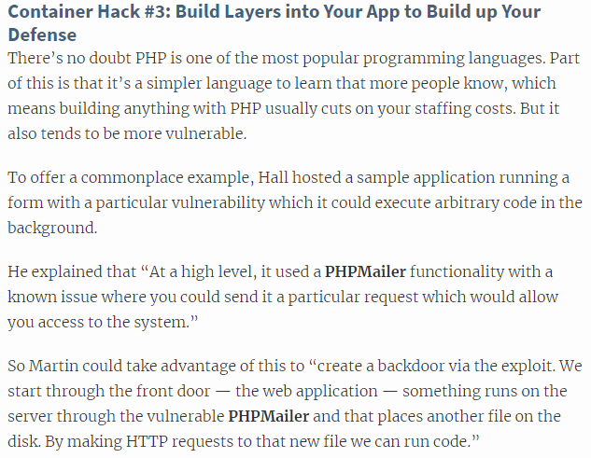
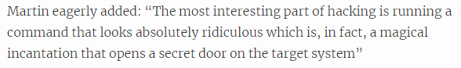
ESCApING THE CONTAINER
https://thenewstack.io/four-security-lessons-live-container-hacking/

Slide 23
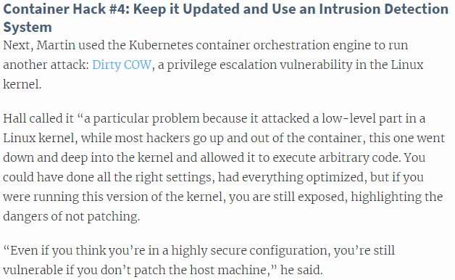
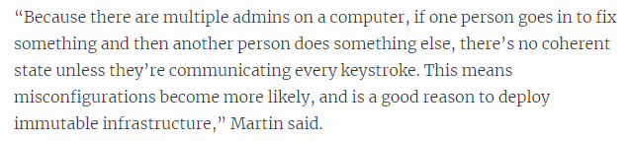
ESCApING THE CONTAINER
https://thenewstack.io/four-security-lessons-live-container-hacking/

Slide 24
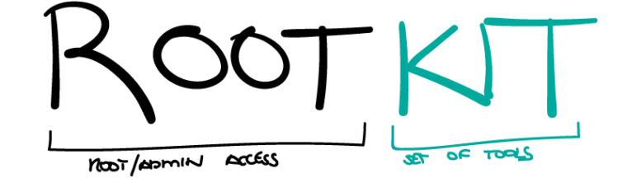
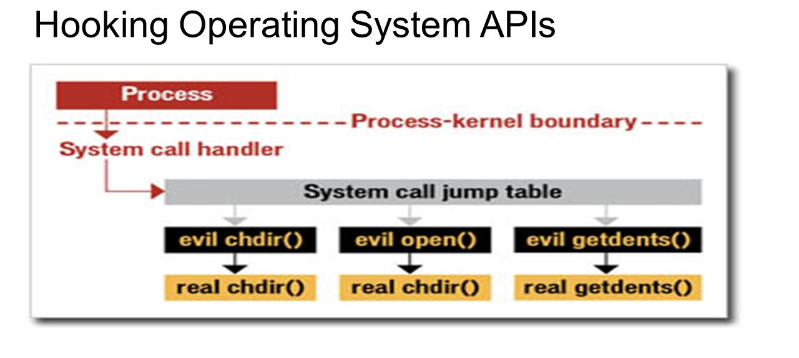
Rootkits
Rootkits live in Ring 0.
Invisible from above, but what about from below?

Slide 25
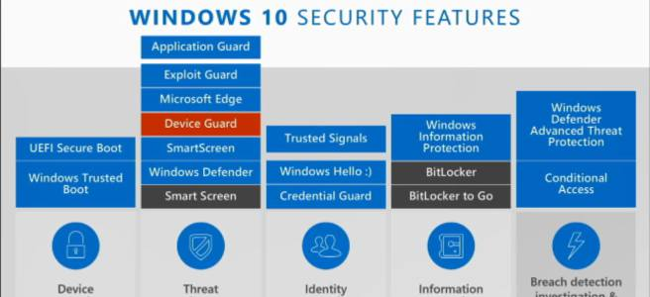
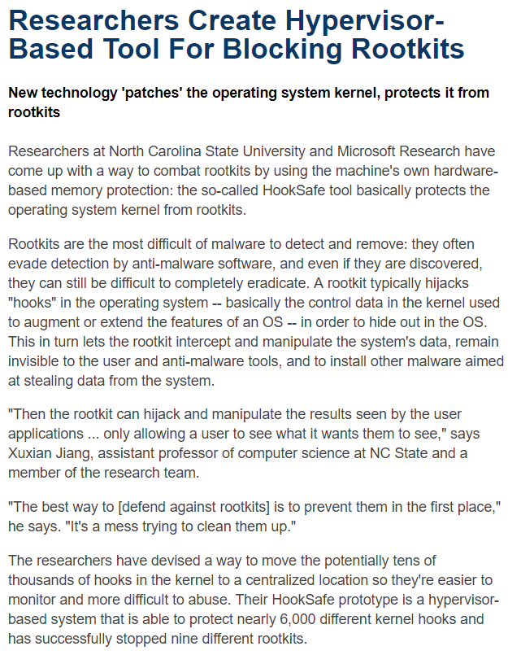
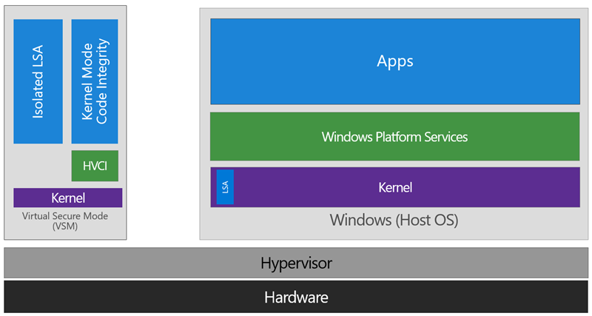

Kits against kits
https://www.microsoft.com/en-us/research/wp-content/uploads/2016/02/hooksafe-ccs09.pdf
https://blogs.technet.microsoft.com/ash/2016/03/02/windows-10-device-guard-and-credential-guard-demystified/

Slide 26





Blue PILL / red pill
Virtual-machine / hypervisor based rootkits
Potential detection methods:
1.
2. Timing against external clock
~50% false positives
https://web.archive.org/web/20070709174407/http://www.offensivecomputing.net:80/files/active/0/vm.pdf

Slide 27



Blue PILL / red pill
Very old idea..
Definitely not a Turing simulation, perhaps unknown quantum computer simulation.
A philosophical dead-end..?
https://web.archive.org/web/20070709174407/http://www.offensivecomputing.net:80/files/active/0/vm.pdf

Slide 28



BootkitS – ESCAPING SECURE BOOT etc
Survives formatting and reinstallation.
https://business.f-secure.com/f-secures-guide-to-evil-maid-attacks

Slide 29





HARDWARE backdoors
https://www.wired.com/2014/12/hacker-lexicon-backdoor/

Slide 30



HARDWARE backdoors

Slide 31








HARDWARE backdoors

Slide 32



HARDWARE INTERDICTION

Slide 33



Warshipping

Slide 34




NSA backdoors

Slide 35


NSA backdoors
If a backdoor or similar ‘phones home’ it should be possible to detect it with an uncompromised firewall during ‘radio silence’.

Slide 36



Backdoor JOKES

Slide 37



WIN OS ØVELSE
Kan du cracke applicationen i en debugger?
Se link på Blackboard

Slide 38


WIN OS ØVELSE

